Slide 1
Chapter 15
Textbook questions

Slide 2
Question 15-5
Why do some absorbing compound fluoresce but others do not?
Compounds that fluoresce have structures that slow the rate of nonradiative relaxation to the point where there is time for fluorescence to occur.
Compounds that do not fluoresce have structures that permit rapid relaxation by nonradiative processes.

Slide 3
Question 15-6
Discuss the major reasons why molecular phosphorescence spectrometry has not been as widely use as molecular fluorescence spectrometry?
The triplet state has a long lifetime which makes it susceptible to collisional deactivation.
Thus, most phosphorescence measurements are made at low temperature in a rigid matrix or in solutions containing micelles.
Also, electronic methods must be used to discriminate phosphorescence from fluorescence. Not as many molecules give good phosphorescence signals as fluorescence signals.
As a result, the experimental requirements to measure phosphorescence are more difficult than those to measure fluorescence and the applications are not as large.
訊號弱、反應時間慢、易將能量傳給solvent，所以不好測

Slide 4
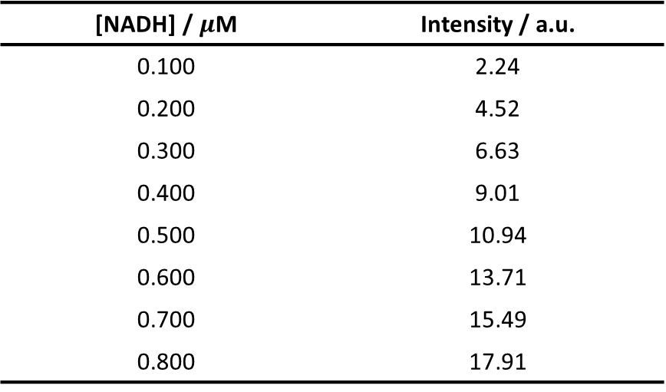
15-7
The reduced form of NADH is an important and highly fluorescent coenzyme. It has an absorption maximum of 340 nm and an emission maximum at 465 nm. Standard solutions of NADH gave the following fluorescence intensities
[NADH] / $μ$M | Intensity / a.u.
0.100 | 2.24
0.200 | 4.52
0.300 | 6.63
0.400 | 9.01
0.500 | 10.94
0.600 | 13.71
0.700 | 15.49
0.800 | 17.91
Construct a spreadsheet and use it to draw a calibration curve for NADH
Find the least squares slope and intercept for the plot
Calculate the standard deviation of the slope and the standard deviation about regression for the curve
An unknown exhibit a relative fluorescence intensity of 12.16. Use the spreadsheet to calculate the concentration of NADH
Calculate the relative standard deviation for the result in (D)
Calculate the relative standard deviation for the result in (D) if the result of 7.95 was the mean of three measurements

Slide 5
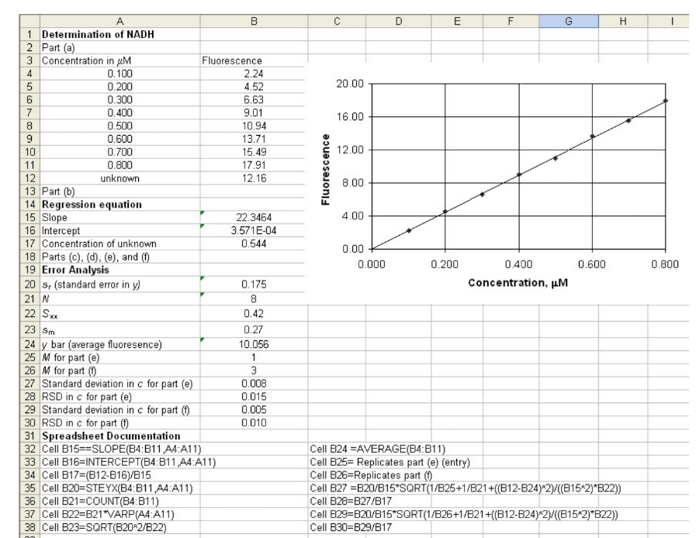

(e) 1.5% (f) 1%

Slide 6
Chapter 16
Textbook questions

Slide 7
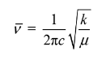
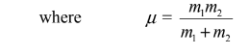
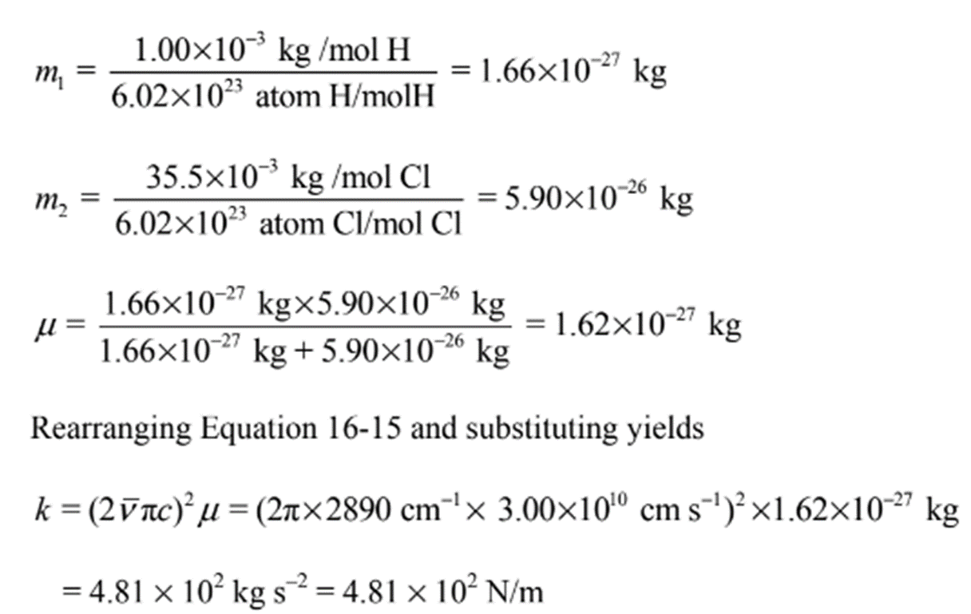
16-2
Gaseous HCl exhibits an IR absorption at 2890 cm-1 due to the hydrogen-chlorine stretching vibration.
Calculate the force constant for the bond
Calculate the wavenumber of the absorption band for DCl assuming the force constant is the same as that calculated in part (a).
(a)
Using the following equation to get k

Slide 8
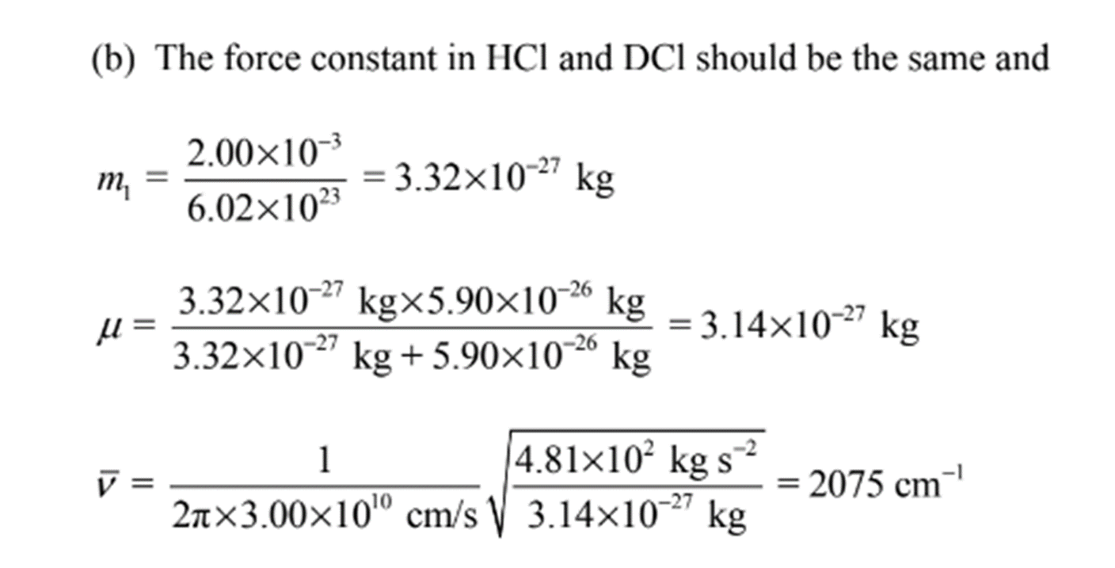
16-2
Gaseous HCl exhibits an IR absorption at 2890 cm-1 due to the hydrogen-chlorine stretching vibration.
Calculate the force constant for the bond
Calculate the wavenumber of the absorption band for DCl assuming the force constant is the same as that calculated in part (a).
(b)

